Slide 1


博富特咨询
Hand Safety Training 双手安全培训
全面
专业
实用
1

Slide 2


关于博富特
博富特培训已拥有专业且强大的培训师团队-旗下培训师都拥有丰富的国际大公司生产一线及管理岗位工作经验，接受过系统的培训师培训、训练及能力评估，能够开发并讲授从高层管理到基层安全技术、技能培训等一系列课程。
我们致力于为客户提供高品质且实用性强的培训服务，为企业提供有效且针对性强的定制性培训服务，满足不同行业、不同人群的培训需求。
博富特认为：一个好的培训课程起始于一个好的设计,课程设计注重培训目的、培训对象、逻辑关系、各章节具体产出和培训方法应用等关键问题。

Slide 3
Hand Injury Statistics手部伤害统计

Slide 4
“The Next Step” 下一步措施
Hand Injuries account for most of our serious injuries. Safety incidents have long been a major source of injuries. We must reduce these so we must target the specific injury sources.
手部伤害在各类重大事故中占了大部分比例，安全事故是导致伤害的主要源头。一定要瞄准具体的伤害源头以减少类似事故的发生
Can we take the same approach to hand safety that we took towards safety - Prevention first, protection second?
能否以同样的安全的方式来对待手部安全—先预防，后保护？

Slide 5
“The Next Step” 下一步措施
Take a moment to hold your hands out in front of you. Look at them. They are the only two hands you will ever have. Do you have any scars?
伸出双手观察一下，人这辈子就只有两只手，看看上面有没有伤疤？
It has been estimated that almost 20% of all disabling accidents on the job involve the hands. Without your fingers or hands, your ability to work and live an active life, would be greatly reduced.
据统计20％的伤残事故都发生在手上。没有了手或手指头，个人工作及生活的积极性将会大打折扣。

Slide 6
“The Next Step” 下一步措施
Image what will change your life you you lost your hands
想象一下没有了双手，你的生活将会是怎样的？
Human hands are unique. No other creature in the world has hands that can grasp, hold, move, and manipulate objects like human hands. They are one of your greatest tools and assets. And, as such, must be protected and cared for.
人类的手是独一无二的。世界上没有任何生物具备可以像人类一样灵活自如地抓提掌控物体之双手。双手就是最好的工具和资产，因此必须要好好保护才行。

Slide 7
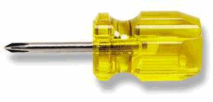
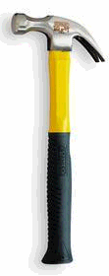
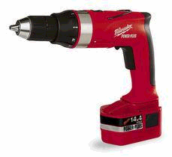
Hand Hazards 手部风险
How would you answer this question?
请回答如下问题：
“What is the most used tool in industry?”
工业领域里最常用的工具是什么？
  Hammer 锤子
  Screwdriver 改锥
  Drill 电钻
  Crescent wrench 扳手
  Pliers 钳子

Slide 8
Hand Hazards 手部风险
The most used tool is:
最常用的工具是：
Try writing without using your thumb
没有拇指写字试试看
Try holding a hammer with only two fingers
只用两根手指头握一下锤子试试看
Try using any man made tool without your hands
不用手使用任何其它人造工具试试看
Hand protection is important because our hands are exposed to so many hazards in the workplace
手经常处于多种风险当中，因此保护双手尤为重要

Slide 9
Requirements for Hand Protection对手部防护的要求
General Requirements
总体要求
  We shall train and require employees to use appropriate hand protection
  when employees’ hands are exposed to hazards such as those from skin absorption of harmful substances; severe cuts or lacerations; severe
  abrasions; punctures; chemical burns; thermal burns; and harmful
  temperature extremes.
  我们将针对手部接触有害物质、割伤、划伤、挫伤、刺伤、化学烧伤、烫伤及高温伤害等危害进行相关培训

Slide 10
Work Practices 伤害的机会及预防
Blades which can cut or amputate your fingers or hands.
锋利的片状物可切断手或手指头
- Use push sticks and tongs to keep your hands away from blades or hot objects.
用棍子或钳子把薄片或其它高温物体挪开
- Cut away from the body when using a knife
用刀具切割时离身体远一点
Rough surfaces and sharp edges which can scrape or cut the skin.
粗糙表面及锋利边角会刮伤或切入皮肤
- Use a grinder or file to remove the rough surface.
用磨光机或挫刀磨平表面

Slide 11
Work Practices 伤害的机会及预防
Machinery which can pinch or crush your fingers.
机器会夹伤或压碎手指
- Make certain the equipment has been locked out and all energy sources has been disconnected.
作业前设备上锁，切断水电气等。
- Machine guards in place and operable
设有可操作的设备防护挡板

Slide 12
Work Practices 伤害的机会及预防
Consider the force of gravity. 考虑重力影响
- Keep your hands out from under suspended or elevated loads.
不要把手放在悬空物体或载荷之下
Pry bars or supports slipping/ failing 撬棍或支架滑落
Missing the target with a hammer 锤击偏位
- Keep your hands out of the line of fire 不要把手放在触发路径上

Slide 13
Work Practices 伤害的机会及预防
Chemicals which can irritate or burn the skin
造成皮肤刺激或烧伤的化学品
Make certain that the gloves that your have on are the correct ones.
确保防腐手套选用得当
Heat and Cold 骤冷骤热
- Cool off hot material before handling it, even gloved, erect a barrier against cold and hot surfaces).
受热物体冷却后方可加工，即使戴了手套也要在冷热物体的表面加一层防护层

Slide 14
Pinch Points (Hand Traps)夹接点
A pinch point can exist anytime two objects come together. An example is where a closing door and door frame come together.
任意两个物体放在一起就可以形成夹接点，例如，关门时门和门框就形成了夹接点
Here are some actual cases of pinch points:
如下为一些夹接点的实际例子：
  An Iron worker injured his fingers when a beam shifted and pinched his fingers between the beam and the concrete floor.
  某钢结构工人在安装横梁时发生偏转，手指夹在了横梁与混凝土之间
  A pipe fitter put his hand over the end of a pipe. A helper moved another pipe which hit the pipe fitter’s hand.
  某管工把手放在管子末端，此时辅工正在挪动另一管子，结果碰在了管工的手上

Slide 15
Pinch Points (Hand Traps)夹接点
In both examples, gloves did little to prevent the injury. The key to prevent
hand injuries as a result of pinch points is to think about where your hands
are placed and avoid them all together. To do so requires hazard
identification.
上述两种案例当中手套基本不起保护作用，防止夹接风险的关键是要避免把手放在不该放的位置上，因此需要进行风险确认。

Slide 16
Pinch Points (Hand Traps)夹接点
In order to properly position your hands, you must first recognize the hazard and then develop a plan to help keep your hands from being injured. This requires thought and action.
为了把手放在正确的位置，必须要认识风险且根据风险制定一套方案来避免伤害，需要思行结合。

Slide 17
Pinch Points (Hand Traps)夹接点
  Use equipment to move heavy materials when possible, not manual means.
  尽量利用设备搬运重物，避免徒手搬运
  The best safety device for your hands is to use your mind.
  用思想左右您的双手才是最安全的防护方式
  By being alert and aware you can avoid poor positioning of your hands, keep them out of the areas that will harm one of your most valuable tools: your Hands.
  只有时刻保持思想上的警惕才可避免将双手置于不当位置，请用思想意识来保护最珍贵的工具：双手。

Slide 18
Pinch Points (Hand Traps)夹接点
  Keep your hands off the load completely if possible. Use a tag line to control the load.
尽量不要用徒手控制起吊荷载物，要用幌绳来控制荷载
  Do not grab a moving cable, hoist line, or load line with your hands.
  不要用手去抓移动的电缆，吊索或有荷载的绳索
If you see others placing there hands/ fingers in a pinch point, get their attention and stop them.
若发现有人把手放在夹接点上，请立即制止。

Slide 19
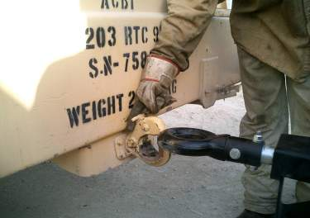
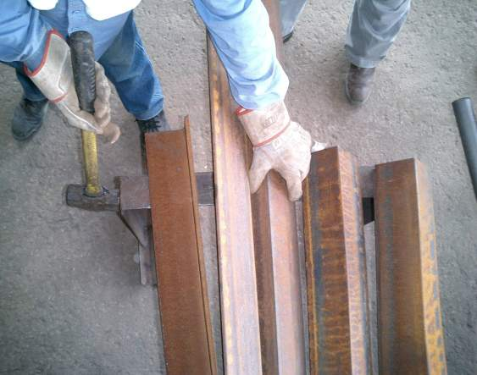
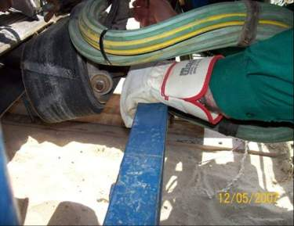
Pinch Points (Hand Traps)夹接点

Slide 20
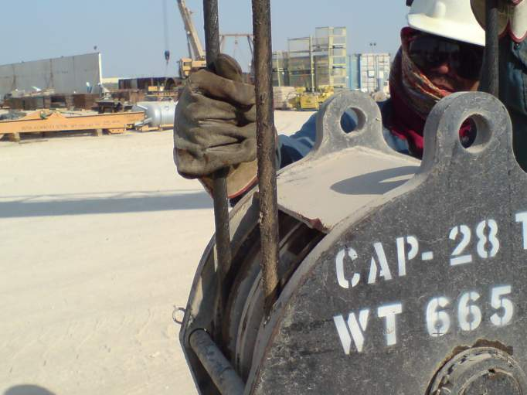
Pinch Points (Hand Traps)夹接点

Slide 21
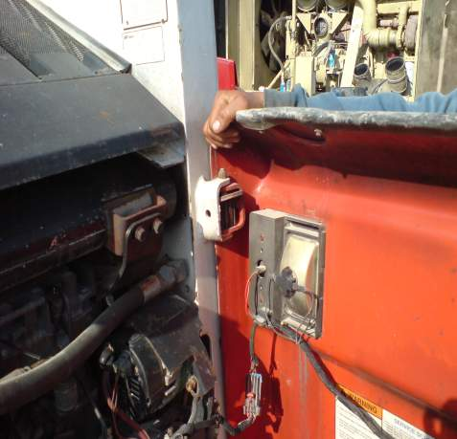
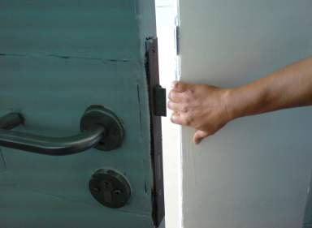
Pinch Points (Hand Traps)夹接点

Slide 22
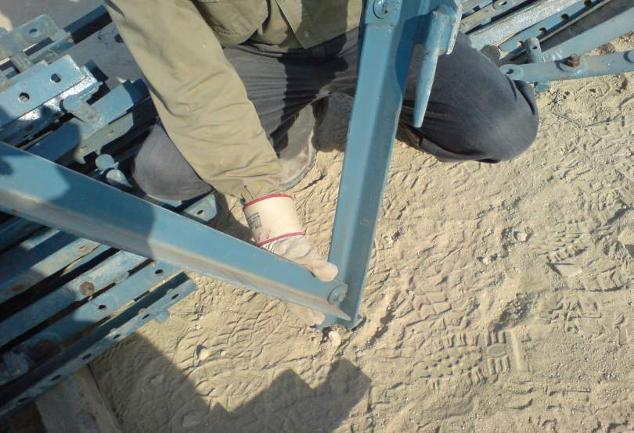
Pinch Points (Hand Traps)夹接点

Slide 23
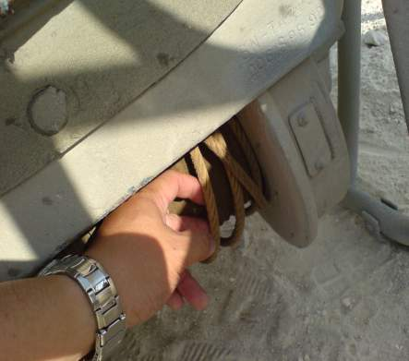
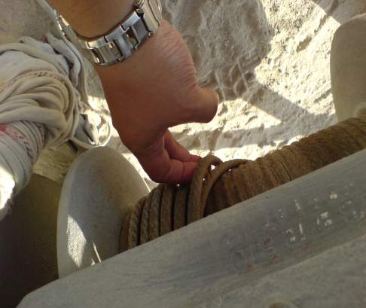
Pinch Points (Hand Traps)夹接点

Slide 24
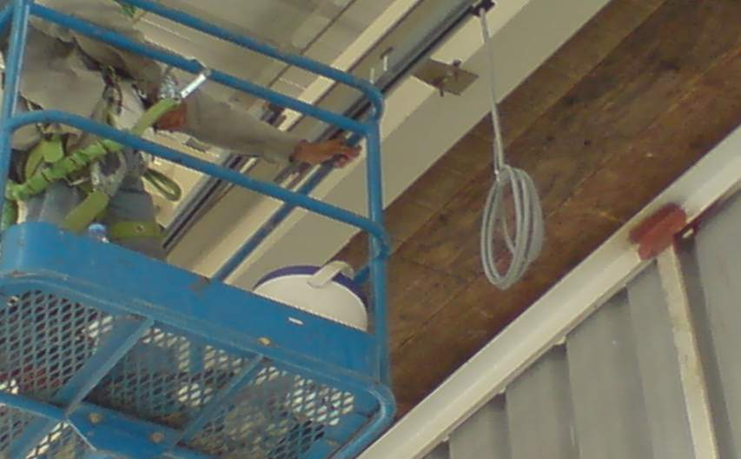
Pinch Points (Hand Traps)夹接点
Don’t forget to use a proper Anchor point!选用恰当的系挂点！

Slide 25
Stored Energy 蓄存的势能
Firstly let’s define stored energy
蓄存势能的定义
Stored energy is potential energy that could be released unexpectedly if it is not controlled.
蓄存势能是指某种不加控制即可随时释放的潜在势能
Examples: 例如
- Hydraulic fluids under pressure 带压的流体
- Compressed air 压缩空气
- Energy stored in springs 弹簧中蓄存的势能
- Process chemicals under pressure 带压的工艺化学品
- Potential energy from elevated objects (Gravity)高空物体的势能（重力势能）

Slide 26
Stored Energy 蓄存的势能
What can we do to protect our hands from stored energy?
如何避免双手受到蓄存势能的伤害？
First, we need to recognize that it exists. Stored energy is not always recognized. The electrical power on a piece of shop equipment may be locked out but pressure may still be present in a hydraulic cylinder.
首先要意识到其真实存在性，并非所有蓄存势能都能得到确认。设备的电源可能已经断开了，但是液压缸里可能还残留有压力

Slide 27
Stored Energy 蓄存的势能
What can we do to protect our hands from stored energy?
如何避免双手受到蓄存势能的伤害？
A valve or blind may have pressure against it due to a leaking valve upstream.
由于上游阀门发生泄漏，下游的阀门或盲板也可能带压
An unrecognized high center of gravity may cause a piece of equipment to topple over unexpectedly.
设备的重心没找准也可能造成设备倾覆

Slide 28
Stored Energy 蓄存的势能
What work practices can we follow to prevent hand injuries from stored energy?
遵循何种工作规范可避免蓄存势能对双手造成伤害？
Always Lock and Tag out energy sources.
对能量源挂牌上锁
Look for other multiple energy sources on the same equipment.
全面观察设备的多个能量源
Bleed off stored energy in hydraulic or air cylinders
释放液压或气压缸内的压力
When applying force (push or pull) prepare for the unexpected slip or release. NEVER place your face in the direct line, when using a hand wrench.
用力（推拉）时要防止松动滑倒。使用扳手时，千万不要使面部处于扳手的运动路径上。

Slide 29
Stored Energy 蓄存的势能
Keep hands from under suspended or elevated loads.
不要把手放在悬空或有一定高度的荷载物之下
Consider the force of gravity.
要充分考虑倒重力因素
Use the right tool for the job, and be sure it is in good condition
选用恰当的工具，确保工具状态良好
Recognize that gloves will not fully prevent injury from stored energy.
要充分意识到仅凭手套并不能完全防止蓄存势能的伤害
Remove hands from in the line of fire (Hammers, plate edges, flanges, beams, pipes, doors, grid mesh)
不要把手放在触发路径上（锤子、钢板边缘、法兰、横梁、管道、门、格栅板）

Slide 30
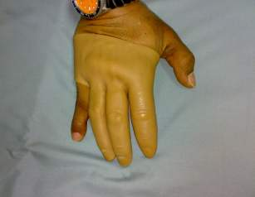
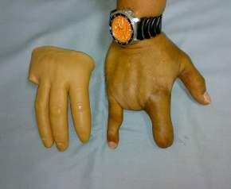
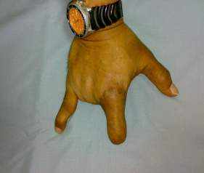
Traumatic Injuries 外伤
You can suffer a traumatic injury to your hands in many ways.
双手受到严重外伤的方式有很多
Tools and machines with sharp edges can cut your hands.
尖角锋利的工具或设备可以割伤双手
Staples, screwdrivers, nails, chisels, and stiff wire can puncture your hands.
订书钉、改锥、钉子、凿子及硬钢丝可以扎伤双手
Hammers, Pry bars can cause crushing injuries. 锤子、撬棍可以压碎双手
Getting your hands caught in machinery can sprain, crush, or remove your hands and/or fingers.
双手绞入机器可以造成手部扭伤，粉碎或者将整其整个吞噬掉

Slide 31
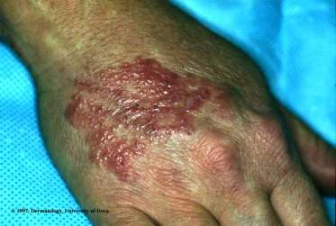
Contact Injuries 接触伤害
Coming into contact with caustic or toxic chemicals, biological substances, electrical sources, or extremely cold or hot objects can irritate or burn your hands.
接触碱性或毒性化学药剂、生化药品、电源、或骤冷骤热物体可导致双手皮肤烧伤或受刺激。
WARNING: Toxic substances are poisonous substances that can be absorbed through your skin and enter your body.
警告：毒性药剂可通过皮肤吸收从而进入体内。

Slide 32
Repetitive Motion InjuriesCarpal Tunnel Syndrome (CTS)
重复动作造成的伤害－腕部综合症
Contact Injuries 接触伤害
The pressure of repetitive motion causes tingling, numbness, or severe pain in the wrists or hands.
重复动作导致双手刺痛、麻木，或者腕部剧痛
Short, frequent breaks with exercise to the wrist, elbows and shoulders will increase circulation and allow the body to recover from repetitive movements.
经常短暂休息活动手腕，肘及双肩可促进血液循环，进而缓解重复动作带来的疲劳
Keep the wrist in a straight (neutral) position when ever possible,
and reduce the speed and force of movements involving the wrist.
随时将手腕放直（中性位置）并减少腕部动作的速度及力度

Slide 33
Contact Injuries 接触伤害
Repetitive Motion InjuriesCarpal Tunnel Syndrome (CTS)
重复动作造成的伤害－腕部综合症
However, surgery is expensive and does not guarantee long term relief.
手术费用昂贵而且并不能长期缓解症状
Some other treatments include medication or splints which allows worker to use the hand, but prevents him or her from bending it.
也可采用药物治疗及安装固定夹板来活动双手，但不能屈臂
Avoid anything that hampers wrist circulation.
尽量避免阻碍手腕处的血液循环
Grasp objects with the whole hand or as many finger as possible.
抓取物体时尽量使用整只手，尽量多动用几根手指头

Slide 34
”The First Defense”第一道防护
Machine guards protect hands and fingers from moving parts and shall not be altered or removed.
机器上的安全挡板可保护手及手指免受动设备的伤害，不得修改或随意拆除。
Good housekeeping practices are also an important part of a prevention plan for hand protection.
保持文明施工，做好场地清理也是保障双手安全的重要预案
Remove nails or bend them over – they could puncture the hand
清除或压弯钉子。钉子可能扎伤双手

Slide 35
”The First Defense”第一道防护
Germicidal soaps, and cleansing creams remove dirt, grease and other chemicals from the skin after exposure.
用灭菌肥皂及洗手液清洗皮肤上的脏物，油污及其他化学品
Good housekeeping also applies to tools and your work area. Cluttered aisles, sloppy work habits also can contribute to hand and other injuries.
做好设备及工作区域的清理。不良的工作习惯及拥塞的通道都可能造成手部伤害或其它伤害

Slide 36
”The First Defense”第一道防护
Use the handles on grinders and power tools – holding a grinder with one hand while holding the object in the other often results in injury
使用磨光机及其他电动工具的手柄，一手拿磨光机一手拿物体往往会酿成伤害事故
Tool holders used
使用工具座
Asking yourself what if?
随时问自己万一…会这么样?

Slide 37
Personal Protective Equipment 劳保用品
Gloves can help reduce the frequency and severity of hand and finger injuries.
手套可减轻或减少伤害
Gloves protect your hands, wear them always.
手套可保护双手，要随时穿戴
PPE is available in forms of gloves and barrier creams.
有各种手套及防护油脂
Asbestos Gloves or Asbestos lining are PROHIBITED.
不得使用石棉手套或石棉衬里
You must wear the correct glove for the job.
专门的作业需要专用手套

Slide 38
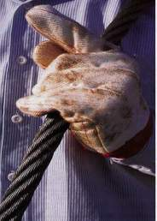
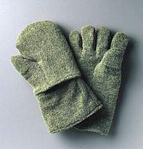
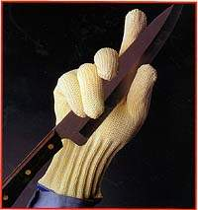
Personal Protective Equipment 劳保用品
Leather gloves protect your hands from rough surfaces.
皮手套可防止粗糙面的伤害
Special insulated gloves can provide protection from hot or cold objects.
绝热绝冷手套可防止骤冷骤热物体的伤害
Puncture resistant gloves for hazards with sharp points( i.e. stainless tie wire for insulators)防穿刺手套可防止尖锐物体的伤害（例如，保温工使用的不锈钢钢丝）
Cut-resistant gloves prevent or reduce cuts from knives or sharp edges.
防切割手套可防止或减少刀具或尖锐锋利物体的伤害

Slide 39
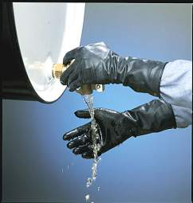

Personal Protective Equipment 劳保用品
Various kinds of chemical resistant gloves prevent contact with chemicals.
防腐手套可防止接触化学品
Disposable gloves protect against blood and germs when providing first aid to a bleeding victim.
医用一次性手套在对流血的伤员实施急救时，可起到止血作用并防止细菌感染

Slide 40
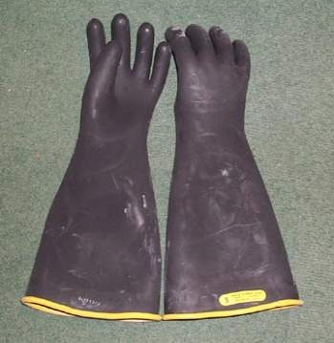
Personal Protective Equipment 劳保用品
CERTIFIED LINEMAN’S GLOVES高压绝缘手套
These specialty gloves are used to handle live wires or energized electrical equipment.
本专用手套主要用于处理带电的电缆或设备
They must be electrically tested every 6 months
每6个月要进行一次绝缘测试
They can’t be used if not tested within past 12 months.
过去12个月内没有进行绝缘测试的手套不得使用
Check for obvious signs of wear or holes before using.
使用前检查有无明显的破损或漏洞

Slide 41
Glove Limitations手套限制
Gloves can get caught in rotating machinery.
手套可能绞入动设备当中
Some people are allergic to latex gloves.
有些人对胶手套过敏
Gloves can actually cause more problems if chemicals get inside glove.
若化学品渗入手套会带来更多问题

Slide 42
Glove Limitations手套限制
Gloves can fail in conditions of extreme temperatures, high mechanical force, high vibration or handling extremely harsh chemicals.
遇到极端温度，极大机械作用力，高度振荡或极强的化学品都可能导致手套失效
There are several types of chemical gloves. Be sure you know what type will protect you against the chemical you are handling. Refer to the MSDS.
有各种防腐手套，使用时要正确选用，请参阅MSDS

Slide 43
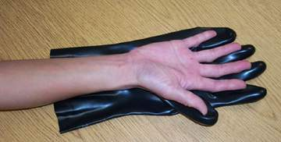
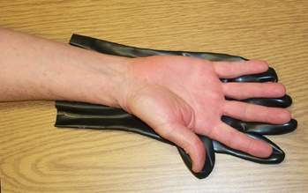
Glove Size & Fit 手套尺寸
Wear only gloves that fit your hands.
选用与手形匹配的手套
Gloves that are too small can tire your hands
手套太紧可能导致手部疲劳
Gloves that are too large are clumsy to work with.
手套太松可能工作时不方便
Wearing gloves around moving equipment, shall be done with great caution. The glove may get caught and pull your hand into the machinery.
在动设备旁边戴手套要多加注意，手套可能被机器夹住连手一起拽入机器。
Too big 尺寸太大了
A better fit 差不多

Slide 44
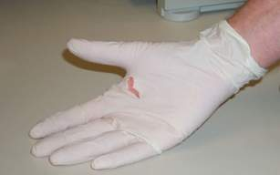
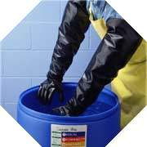
Glove Use & Care手套使用保养
Replace gloves if they have cuts, tears, holes or defects.
手套上有裂口，破洞及磨损缺陷应及时更换
Make sure gloves are the right length for the job.
确保手套长度符合工作要求

Slide 45
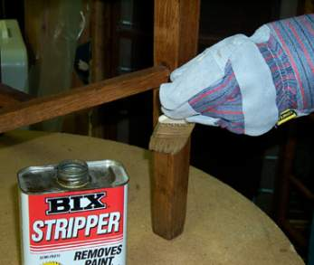
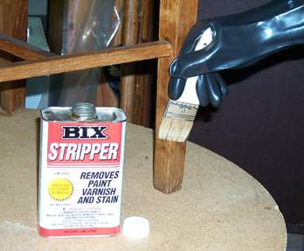
Glove Use & Care手套使用保养
Use the right glove for the job!
选用正确的手套进行作业！
Don’t use fabric or leather gloves to handle liquid chemicals.
不要用布或革质的手套处理液态化学品
No!不行
Yes!行

Slide 46
Chemical Resistant Gloves 防腐手套
Chemical-resistant gloves are not totally “chemical-proof”
防腐手套并非完全“防腐”
Chemicals will eventually penetrate the gloves over time.过久接触化学品会至其渗入手套
Chemicals will also break down (swell, crack or weaken) the glove material over time.
过久接触化学品也会减弱手套的防护性能（发胀、裂纹或变软）
In general, the thicker the glove, the more resistant it is to chemicals.
总之，手套越厚，抗腐蚀能力越强
Thick is better than Thin
厚比薄好

Slide 47
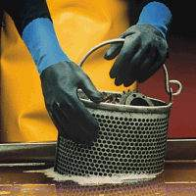
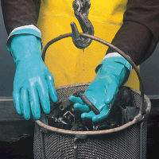
Chemical Resistant Gloves 防腐手套
No single glove material will protect against all chemicals.
没有任何一种材料可以单独抵挡所有化学品
Gloves are selected according to the type of chemical.
不同的化学品要选用不同的手套
Good chemical gloves are made of Viton®, butyl, nitrile, neoprene, or PVC or combinations of these.
好的防腐手套是由聚氯乙烯、氯丁橡胶等制成或合成的

Slide 48
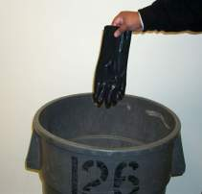
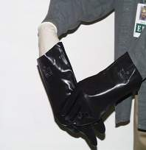
Using Chemical Resistant Gloves防腐手套的使用
You should know what chemical you are handling and how long the gloves will keep the chemical out.
应该事先了解所接触的具体化学品名及手套的防护时间限制
Throw away gloves whenever degradation is visible or you know chemicals have leaked inside.
发现破损立即更换，或感觉有渗漏时立即更换
When handling highly toxic chemicals, two layers of chemical-resistant gloves can provide additional protection.
处理剧毒化学品时可用双层防腐手套，双重防护

Slide 49
10 Rules for Hand Safety 手部安全的10条准则
1
Keep hands away from pinch points and crushing hazards. Pinch point injuries and crushing injuries are common both at work and at home. Exercise caution when working with hammers, presses, or any piece of equipment that might pose a hazard to your hands.
不要把手放在夹接点或有挤压风险的地方。夹接和挤压伤害风险在工作和家庭生活中都比较常见。使用锤子，冲床或其它容易伤手的设备时要多加小心。
2
Inspect materials for slivers, jagged edges, burrs, and rough or slippery surfaces before handling. Put on gloves or take other precautions to protect your hands. Wipe off greasy, wet, slippery, and dirty objects before handling.
搬运材料时，应事先检查设备有无尖角，毛刺或其它粗糙表面。戴上手套，并清除材料上的油污及脏物。

Slide 50
10 Rules for Hand Safety 手部安全的10条准则
3
ALWAYS wear suitable gloves unless operating rotating equipment such as drill presses, floor mounted threading machines, bench grinders, table saws, etc.
除非操作冲击钻，落地式套丝机，台式磨光机或台锯等动设备，手套必须经常穿戴。

Slide 51
10 Rules for Hand Safety 手部安全的10条准则
4
Remove jewelry where applicable. Most people wear rings as a matter of habit and seldom stop to think about what would happen if the ring got caught on something and would not give. One company did a study and found that it took 1,670 pounds of pull to separate a ring. Therefore, it is doubtful that a ring will give before the finger.
取下珠宝首饰。很多人出于习惯佩戴首饰但很少考虑万一戒指被其它东西挂到而取不下来的情况。某公司做了个研究，发现至少要用1670磅的力气才可将戒指取下来。因此，戒指一旦被东西挂住，先取下来的肯定是你的手指头而不是戒指。

Slide 52
10 Rules for Hand Safety 手部安全的10条准则
5
Use the correct hand tool for the job and use it properly.
正确使用恰当的工具
Examples of improper use include:
不良使用包括：
    Knives – Using a knife instead of snips or cutters.
    刀具—用刀具代替剪刀或切割机
    Wrenches – Using as a hammer.
    扳手—扳手当锤子用
    Screwdrivers – Using as a wedge or pry bar.
    改锥—改锥当楔子或撬棍用
    Hammers – Using the wrong type of hammer.
    锤子—锤子型号不当
    Power Tools – Using the wrong type of power tool.
    电动工具—型号不当

Slide 53
10 Rules for Hand Safety 手部安全的10条准则
6
Make sure safety guards are in place before you begin any job. Machine guards have been installed to protect you. When you bypass them, you risk serious injury to yourself or others. Know what guards should be on all your tools and / or equipment. 开工前确保安全挡板设置妥当，设备上的安全挡板是用来保护你的，置之不理会将自己和他人置于严重的风险之中。要明确设备工具上都需要哪些挡板。

Slide 54
10 Rules for Hand Safety 手部安全的10条准则
7
Never reach into machinery to repair, oil, or adjust without using proper Lock Out / Tag Out Procedures. Lock Out / Tag Out rules are designed to prevent the accidental start-up of machinery.
没有挂牌上锁程序千万不要把手伸到机器里从事维修，加油或调校等。挂牌上锁程序主要用于预防设备突然启动。

Slide 55
10 Rules for Hand Safety 手部安全的10条准则
8
Clean up with a rag, brush, or broom. Protect your hands by using a rag, brush, or broom for cleaning. Also, wear your gloves while cleaning.
用布，刷子或扫帚等打扫卫生，过程中要戴上手套
9
Know the danger zones
明确危险区域

Slide 56
10 Rules for Hand Safety 手部安全的10条准则
10
Keep your hands clean. Do not ignore any hand injuries. Know the signs of dermatitis and other skin disorders. Get prompt medical attention when required. Protect your hands by keeping them as clean as possible at all times. Wash them after direct exposure to any chemicals and always before you eat, smoke, drink, or apply any lotion or make-up. Get prompt medical attention for hand injuries.
保持双手清洁。不要忽略任何手部伤害。要掌握皮肤炎及其它皮肤病的症状，必要时看医生去。要经常洗手，接触化学品、化妆、抽烟、饭前便后等都要洗手。手上受伤后要马上看医生。

Slide 57
Closing Remarks 结束语
There are few activities on or off the job that do not require the use of your hands and arms in some way.
工作和生活中几乎没有不动双手就可以办到的事情
Driving, eating, writing, and even holding your loved one - the list can go on and on.
开车、吃饭、写字、拥抱—可以列出一长串
Make sure your hands last a life time, they are the only pair you will ever get!
请确保这辈子不要丢掉双手，丢了就没了！
Protect your most valuable tools: YOUR HANDS
请保护好您最珍贵的工具：您的双手
And DON’T be the next victim like these people were…
千万不要沦为下一个他们……

Slide 58


感谢聆听
资源整合，产品服务
↓↓↓
公司官网 | http://www.bofety.com/
如需进一步沟通
↓↓↓
联系我们 | 15250014332 / 0512-68637852
扫码关注我们
获取第一手安全资讯
微信公众号
抖音

