Slide 1
Behavioral Safety Visit
行为安全观察
Level Standard - Language English
A management approach to develop safe behaviors and reduce injuries
发扬安全行为和减少伤害的一种管理方法
Owner : SIS
Corporate training IN-TQ-HSE-007 - 02 - 2008
Notes:
The Behavioral Safety Visit is a key means of sustainably eliminating unsafe actions and conditions
It serves :
to identify gaps between standards and actual practice in the field
To verify that there are standard procedures and that these are appropriate, and to redefine them if necessary
To listen to and dialog with employees
To reduce or even eliminate any gap observed.

Slide 2
关于博富特
博富特培训已拥有专业且强大的培训师团队-旗下培训师都拥有丰富的国际大公司生产一线及管理岗位工作经验，接受过系统的培训师培训、训练及能力评估，能够开发并讲授从高层管理到基层安全技术、技能培训等一系列课程。
我们致力于为客户提供高品质且实用性强的培训服务，为企业提供有效且针对性强的定制性培训服务，满足不同行业、不同人群的培训需求。
博富特认为：一个好的培训课程起始于一个好的设计,课程设计注重培训目的、培训对象、逻辑关系、各章节具体产出和培训方法应用等关键问题。

Slide 3
Introduction 前言
Objectives 目标
Its aim is to reduce the number of accidents and incidents linked to unsafe behavior through the implementation of a Behavioral Safety Visit. 通过行为安全观察的执行，减少由不安全行为导致的事故和事件。
At the conclusion of the training the trainees shall know and understand the method and principles to conduct a Behavioral Safety Visit. 培训完成时，培训者应了解并理解进行行为安全观察的方法和原则。
Purpose 目的
This training package is intended for Facility Managers, Industrial Managers, HSE Managers and Managing Directors. 此培训适用于装置经理，工业经理，HSE经理和管理层总监。
After translation into the language of the country and customization to the local conditions, it can be used by the Subsidiary relevant trainers to train the personnel. 被翻译成当地语言并专用于当地条件后，可供下包商相关培训人员使用对其人员进行培训
DISCLAIMER
The information contained in this document has been prepared by L’ Air Liquide S.A. and/or its controlled subsidiaries (“Air Liquide”), exclusively for their use, and is Air Liquide property. Air Liquide believes the information is current and accurate, but circumstances may warrant additional requirements or procedures. This document is subject to periodic review and users are cautioned to obtain the latest edition.
Air Liquide makes no representations or warranties to third parties as to the quality, accuracy or completeness of information contained in this document and EXPRESSLY DISCLAIMS ALL WARRANTIES, INCLUDING, BUT NOT LIMITED TO, THE WARRANTY OF MERCHANTABILITY AND THE WARRANTY OF FITNESS FOR A PARTICULAR PURPOSE.
No part of this document may be copied or otherwise shown or disclosed to third parties without the prior consent of Air Liquide .
Unauthorized use of this document by any third Party, including Air Liquide contractors and subcontractors, shall be at such Party’s own risk, and Air Liquide assumes no liability in connection with information contained herein.
Air Liquide disclaims any liability for any damage suffered by any company or person as a result of or in connection with the use, application or implementation of the information contained herein or any part thereof. The benefit of this disclaimer shall inure to Air Liquide and its affiliates.
This document should not be confused with federal, state, provincial, or municipal specifications or regulations, insurance requirements or national safety codes.

Slide 4
The Behavioral Safety Visit : Session Objectives 行为安全观察：培训目标
Scope of a BSV 行为安全观察范围
Why implement a BSV? 为什么要执行行为安全观察？
How to implement a BSV? 如何执行行为安全观察？
How to engage in a dialog? 如何进行对话？
How to obtain commitment on action? 如何在行动中获得许诺？
Who performs a BSV? 谁来执行行为安全观察？
When to perform a BSV? 什么时候进行行为安全观察？
Practice: real exercise 实践：真实演习

Slide 5
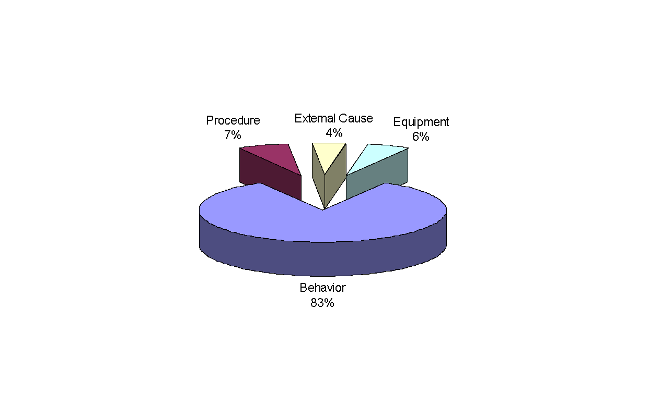
Most Lost Time Accidents have a « behavioral » cause 大多数损时事故都有一个行为原因
AL Group data 2005
液空集团2005年数据
Behavior of the injured person 受伤人员的行为
Behavior of the management/organization 管理/组织行为
Impacts the behavior of the injured employee 影响受伤员工的行为
Can create unsafe conditions 可以导致不安全条件
Notes:
90% of all accidents could have been avoided with appropriate organization, good procedures and behavior.
Many accidents can therefore be prevented by eliminating unsafe actions and behaviors.

Slide 6
Various responses to an unsafe behavior 对不安全行为的各种反应
1/ I can’t do it right !
我做得不对！
2/ I don’t know how to do it right !
我不知道怎么做是对的！
3/ I don’t want to do it right !
我不想做对！
Notes:
1/ I can't do it right
The employee does not have the means necessary to do the job right; therefore, he does his work as best he can, which may of course end in an accident
For example, if I don't have a hammer within reach I will use an inappropriate tool that I can easily access.
Being able to do the job correctly is the most basic condition and involves appropriate means, tools, rules, weather, organization
2/ I don't know how to do it right - this may be due to insufficient information, the misunderstanding of a new process or tool, the ignorance of a rule or method to be observed or simply the fact that the employee is new to the job, a beginner or is hired on a temporary basis.
Training, information and communication result in know-how.
3/ I don't want to do it right - this inappropriate attitude often results from a lack of motivation and therefore from a weak company safety culture
The desire to do things right is the best sign of a strong company culture

Slide 7
The Behavioral Safety Visit 行为安全观察
It’s an accident prevention tool 一个事故预防工具
that aims at detecting and eliminating potential causes of accidents after observation, discussion and agreement with the worker
其目标是在观察、讨论并与员工达成一致后，探测和排除事故潜在原因

Slide 8
Benefit of a BSV : reduce the number of accidents 行为安全观察：减少事故数量
Accidents
事故
BSV + Anomaly Hunt
行为安全观察+异常发现
Incidents, near misses, differences, unsafe behavior, etc. 事件，幸免事件，异常，不安全行为等。
Notes:
The safety visit serves to identify and correct gaps by focusing on the submerged part of the "iceberg", from which the most serious accidents stem.

Slide 9
What characterizes a BSV? 行为安全观察有什么特征？
Based on observing an employee performing a task
基于观察员工执行作业
Based on an open face-to-face discussion
基于一个公开的面对面讨论
Concluded by decisions mutually agreed upon
对互相讨论的结果意见一致
It is focused on people 它关注于人
It is a “Managing act” 它是一种管理行动
It is more than an anomaly hunt visit! 它胜过一次寻异常观察

Slide 10
Who are the key actors in a BSV? 谁是行为安全观察的核心要素？
The Observer: 观察员
The direct supervisor, his manager… 直接主管，他的经理
(N+1 and N+2)
The Observee: 接受观察者
the operator or technician performing his job 正在执行工作的操作员或技术员
The supervisor knows the people, the tasks they perform, the work instructions 主管了解作业人员和他们执行的工作，以及作业指导书
The manager is the person who can make immediate decisions, reinforces the approach through his engagement
经理能立即做出决定，通过他的承诺巩固这种途径
The HSE manager/coordinator can help. HSE经理/协调员可以帮助执行*。

Slide 11
The Behavioral Safety Visit process 行为安全观察步骤
Prepare the scope 准备活动
Observe 观察
Listen
and dialog
倾听和对话
Obtain Commitment
获得许诺
Set priorities
and prepare action plan
设置优先整改项和准备行动计划
Follow-up
on action Plan
追踪行动计划
Notes:
Respect the different steps before engaging in a dialog

Slide 12
The Behavioral Safety Visit process 行为安全观察步骤
Prepare the scope
准备活动
To determine your target 确定观察目标
You plan who you intend to visit
计划你打算观察的对象
You list what you want to see
列出你想要看什么
You make sure you know the procedures of the work place
确信你了解作业场所的程序
You set the duration (between 15 and 20 minutes)
设定时限（15到20分钟）
You make an appointment
安排预约
Notes:
Determine the scope of the visit :
You have decided "who to see“
Only One person on one workstation
when and where.
Doing a defined set of tasks
(It is the difference with an anomaly hunt where the scope is generally an area of the plant)
You make an appointment with the person.
After this first step, it’s very important to introduce yourself when you meet the person and explain again why you are making a BSV before beginning the observation
Don’t forget : the relevance of the observations you obtain will depend on your determination to obtain them.

Slide 13
The Behavioral Safety Visit process 行为安全观察步骤
Observe
观察
Six areas of observation: 6个观察范围
Operator’s reactions 接受观察者的反应
Operator’s actions and positions 接受观察者的动作和位置
Rules and procedures 规则和程序
Protective equipment 防护设备
Tools and equipment 工具和设备
Workstation order and cleanliness 工作场所整齐、清洁状态
Notes:
Before starting to observe :
Ask to stop the work
Introduce yourself
Explain why you are there
Observation can only be effective if you have first decided "what to see". The relevance of the observations you obtain will depend on your determination to obtain them.
The two levels of observation:
Distant observation to detect "fugitive" actions, gain an overall understanding of the work environment and of course to ensure your own safety;
Observation at close range, to complete what was learned from distant observation. but not too close !
Important : Not to distract the operator
From a distance you will focus on PPE, operation actions, reactions and positions. To observe properly you must:
Be stationary and look in front, above, below, behind and inside.
Use your four senses
See, hear, touch and smell.
Observation at close range:
Complete distant observation to detect systematically hazardous conditions
Even when informed, no one likes to be observed!
An employee may therefore sometimes react differently
The usual response to your arrival will be told
Stop work/Modify work/Change position/Adjust (or put on) PPE
Don't forget to note positive points !

Slide 14
The Behavioral Safety Visit process 行为安全观察步骤
Observe
观察
Always ask yourself two questions:
总是要问自己两个问题：
What could happen if … (the unexpected occurs)?
如果……会发生什么（意想不到的情况）？
How could we do it in a safer manner ?
如何用更安全的方式做这件事情？

Slide 15
The Behavioral Safety Visit process 行为安全观察步骤
Listen and dialog
倾听和对话
Approach the employee and engage a dialog :
接近观察者并获得对话：
Say what you have seen
说你看到了什么
Mention everything that is positive and the good practices you have observed
提及你观察到的积极和良好实践的每件事情

Slide 16
The Behavioral Safety Visit process 行为安全观察步骤
Listen and dialog
倾听和对话
Discuss with the operator: 与操作人员讨论
Use open questions: 使用开放性问题：
How could we do this safer?我们怎样更安全地操作？
What are the risks in doing so?这样做有什么风险？
How can we avoid …. ?我们怎样避免……？
Notes:
Explain actions/ behaviors you have observed
Ask the operator questions like :
Is this movement/operation useful and necessary?
Could we do it differently?
What could be the unexpected result?
What would this require?
Employees must be allowed to explain their behavior
You see someone do something dangerous:
Start a conversation with this person about his/her job and the task being performed.
Try to find out why they did this hazardous act.
Ask them what sort of difficulties they encounter during their work.
With this person discuss the applicable work procedure and whether it should be modified.
If there is no procedure discuss whether there should be one! Ask for suggestions.
To study the problem, write a report on it, organize a meeting about it, etc.

Slide 17
The Behavioral Safety Visit process 行为安全观察步骤
Obtain commitment
获得许诺
Do not adopt an attitude of confrontation
不要采用对质的态度
Avoid people gathering around
避免人在周围聚集
Don't stray from the subject
不要偏离主题
Don't let the person change the subject
不要让人们改变主题
Notes:
If you can get your employees to support corrective efforts you will succeed in correcting hazardous practices and poor habits without making them resentful

Slide 18
The Behavioral Safety Visit process 行为安全观察步骤
Summarize the 3-4 main ideas for improving safety
总结3到4点对于改进安全的主要意见
Implement some immediately 立即执行一些改进意见
Close the visit 结束观察
Obtain
Commitment
获得许诺
Get the observee to support the modifications to be made!
Or even better: get him to suggest them!
使接受观察者支持提出的改进意见，让他提出意见更好
You must work together like members of
the same team with the common objective
of improving safety
你必须像和接受观察者同一个团队的人一样和他一起工作，进而实现改进安全的目标。
Notes:
.
.

Slide 19
The Behavioral Safety Visit process 行为安全观察步骤
Closing BSV
关闭行为安全观察
Don’t forget ! 不要忘记！
Thank the employee for his time
感谢员工
Thank the employee for the discussion of ideas
感谢员工对意见的讨论
Ensure him that actions taken will be followed through 确保他能够执行行动措施

Slide 20
The Behavioral Safety Visit process 行为安全观察步骤
Set priorities and
Prepare an action plan
设置优先整改项
和行动计划
Impact on safety improvement
对改进安全的影响
9
1
High
1
2
6
1
2
3
Medium
3
2
3
4
Low
0
3
6
9
Difficulty to implement
执行难度
Easy
Normal
Difficult
Notes:
In setting priorities, choose to address the first action which has the highest impact on safety and which is the easiest to implement (1/green)
Don’t try to do everything at the same time … or you will do nothing or put an unnecessary burden on the teams 🡪 will have a negative impact on the BSV program
Few actions, simple, efficient and implemented

Slide 21
The Behavioral Safety Visit process 行为安全观察步骤
Follow-up on
Actions plan
追踪行动计划
Actions plan is endorsed by management and the people responsible for actions 管理人员和行动负责人签署行动计划
Actions plan is posted 张贴行动计划
Actions plan is regularly updated; Percentage of completion is tracked
定期修改行动计划，追踪完成百分比
Effectiveness is checked and ensured
检查和确认效力
Progress is communicated (and celebrated)!
沟通进展（表示祝贺）

Slide 22
A Good Behavioral Safety Visit is: 一个良好的行为安全观察是：
Focused on people
关注于人
1 or 2 positive points as a minimum
至少1或2个积极意见
A few points to improve or change
几个改进或提高意见
100% dialogue
百分之百对话
80% immediate action
80%当场行动

Slide 23
It is not the « miracle » solution 他并不是奇迹的解决方案 It is complementary to other safety management tools (meetings, trainings, audits, …) 它是对其他安全管理工具（会议，培训，审计）的补充 It requires 100% engagement and belief, good interpersonal & communication skills 它需要百分白的许诺和信任，良好的人与人之间的沟通技巧
The Behavioral Safety Visit : Closing 行为安全观察：关闭
Notes:
A Behavioral Safety Approach will only be successful if
BSVs are done on a regular basis (scheduled)
Operational managers play an active role
Actions are decided and completed
Positive behaviors and changes are highlighted and recognized
It starts as a structured program
But needs to evolve into a Safety Management Attitude
to achieve sustainable « best in class »
safety performance

Slide 24
Behavioral Safety Visit 行为安全观察
EXERCISE
练习

Slide 25
Exercise : principles of the visit 练习：观察原则
The Behavioral Safety Visit for this exercise 行为安全观察练习
Form a group (5 max.), with a manager leader.
分组（最多5人），每组一个领导者
Identify an employee to visit 确定一个访问的人
Six steps: 六个步骤：
10 minutes to prepare 10分钟准备
Observation of the employee (duration 15’ to 20’) in the defined zone
在规定区域对接受观察者进行观察（15到20分钟）
Dialogue and decisions with the observed employee (duration 15’ to 20’)
与接受观察者进行对话并做出决定（15到20分钟）
10 minutes to write the report 编写报告，10分钟
Analysis of the seriousness of the risks and the difficulty of preventive measures 认真分析存在的风险和预防措施的困难
Elaboration of an action plan and definition of priority actions
仔细分析行动计划并定义出优先整改项
Notes:
Carefully select PPE,
What is the person's ultimate means of protection? Is this equipment worn? Are there exceptions to the basic rule? Is there a specific and known rule that can be applied? Is this rule relevant?
Tools and equipment
A poor tool = poor work. Are work tools and equipment in good condition, suitable for the task at hand and used correctly?
Procedures - perhaps the most important point is “Are there procedures?” Are they suitable, known, understood and applied?
Order and cleanliness - The obvious sign that there may or may not be a problem. Is housekeeping adequate? Are sufficient means provided for this and are they readily available?

Slide 26
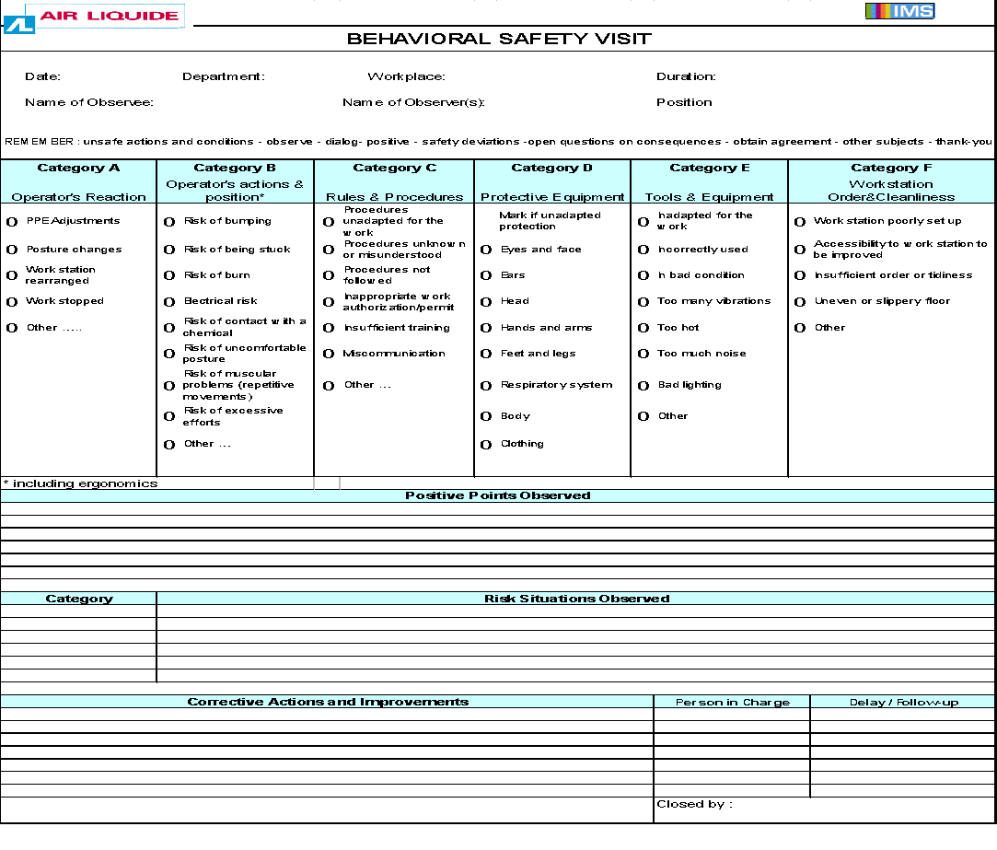
Behavioral Safety Visit form 行为安全观察记录表

Slide 27
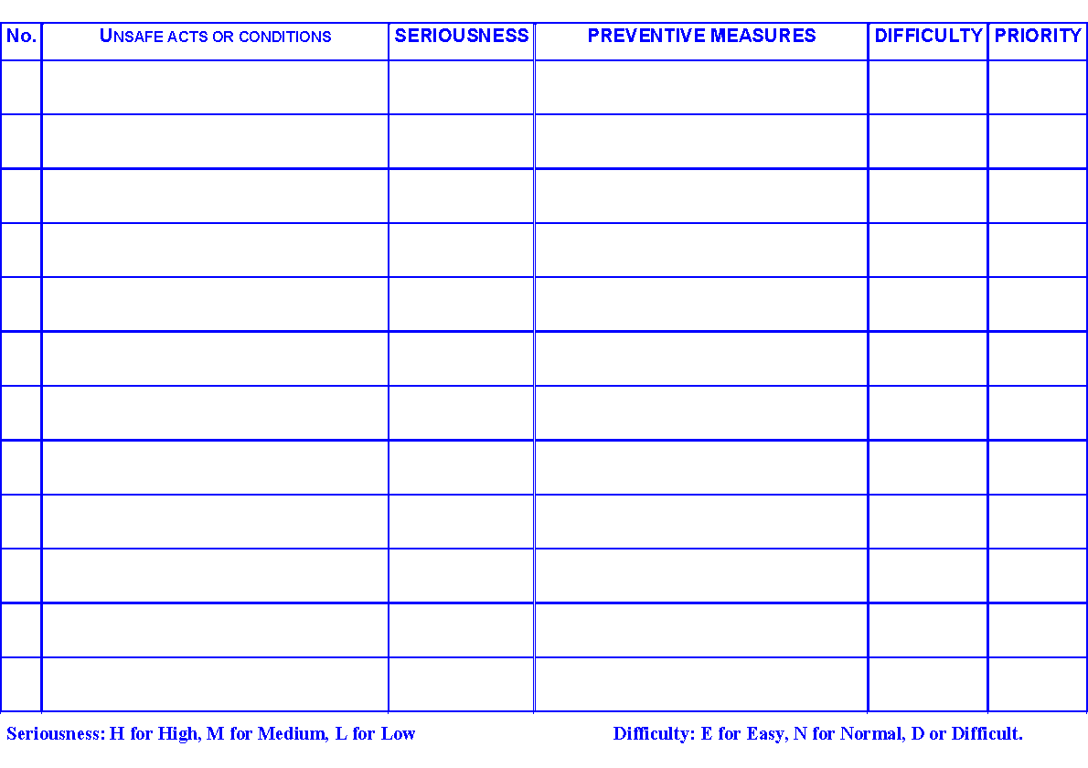
Behavioral Safety Visit :Analysis card 行为安全观察分析卡

Slide 28
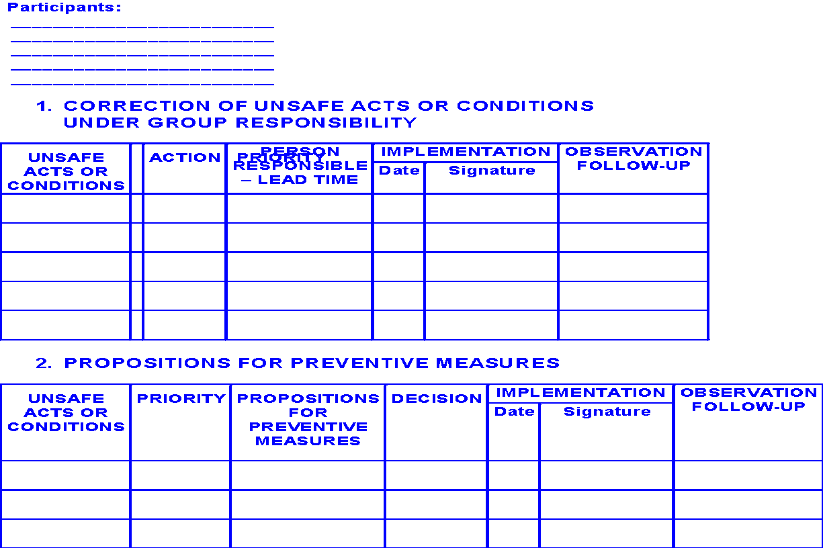
Behavioral Safety Visit : action plan 行为安全观察：行动计划

Slide 29
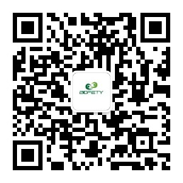
感谢聆听
资源整合，产品服务
↓↓↓
公司官网 | http://www.bofety.com/
如需进一步沟通
↓↓↓
联系我们 | 15250014332 / 0512-68637852
扫码关注我们
获取第一手安全资讯
微信公众号
抖音

